Slide 1
Chan Shu Yi
Class: IT8701
Student ID: P7402944

Slide 2
Background
John and Mary are both young, working adults around the age of 25 – 29 who are looking into settling down and have a place of their own.
Background:
Both John and Mary have a gross household income of $6,000 - $7,999
They are looking into either purchasing either a BTO or Re-sale within their means in the North, East and West vinicity.
Criteria:
Both hold jobs in the central and do not own a car.
They would also like a property that has at least 20% increment from original invested amount after 3 – 5 years.
Both mature and non mature estates are in consideration.
Square feet is not in consideration

Slide 3
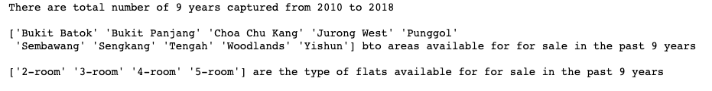
Recent BTO Launch areas in the past 10 years

Slide 4
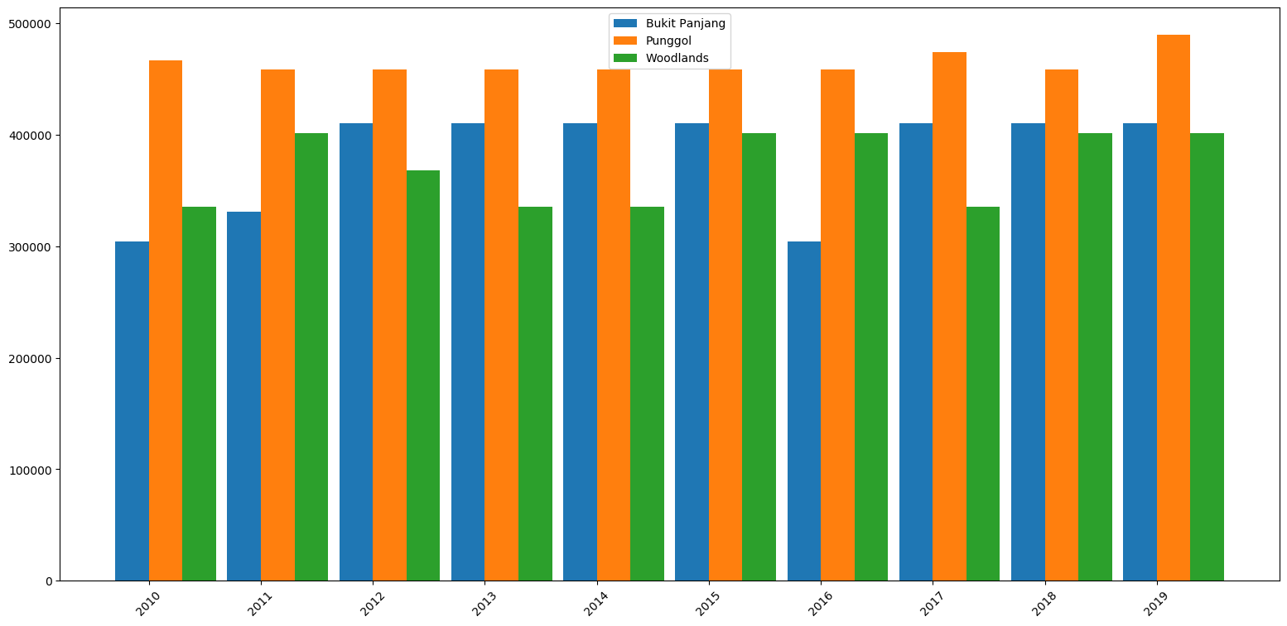
BTO Flats
Notes:
Through out the 10 years,
Punggol has an estimate of more than $450k consistently
Bukit Panjang took a slight dip in 2016 but has increase close to $100k since 2010
Woodlands is consistently around $300 - $400k

Slide 5
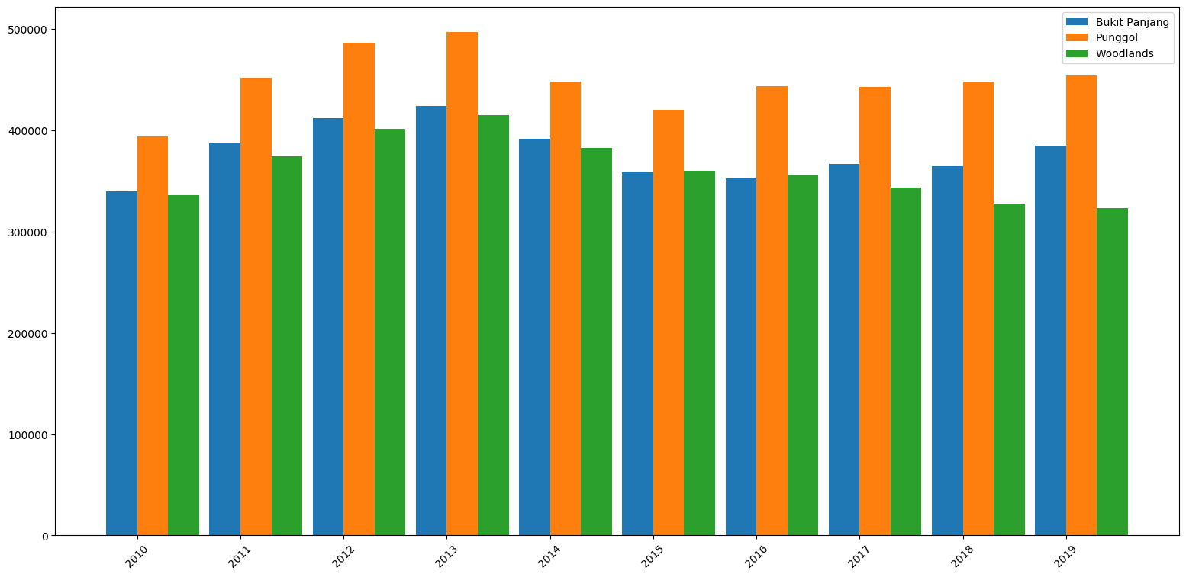
Re-Sale Flats
Notes:
Through out the 10 years,
Punggol only had a spike close to $500k, however the price difference did not vary much from the launch
Bukit Panjang he price difference did not vary much from the launch
Woodlands took the largest hit between BTO vs re-sale

Slide 6
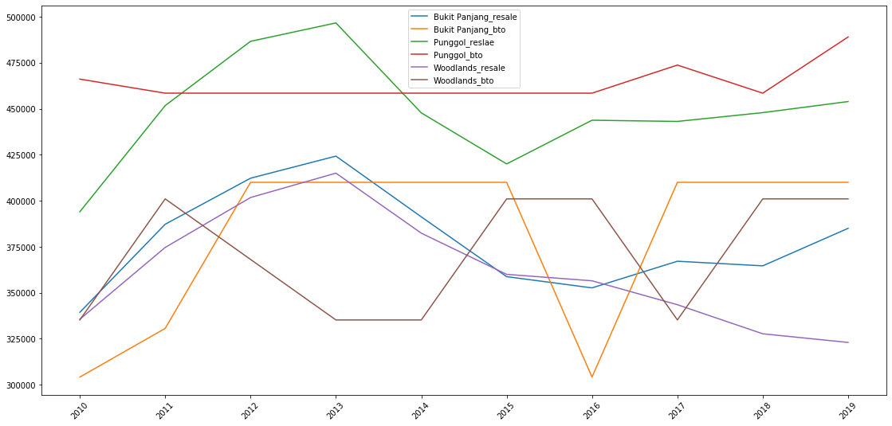
Comparison between re-sale and bto
Notes:
Punggol does not seem to worth the investment as it is the most expensive between these three properties
Bukit Panjang and Woodlands BTO seem to be more consistent with the prices
Bukit Panjang re-sale would be the ideal choice

Slide 7
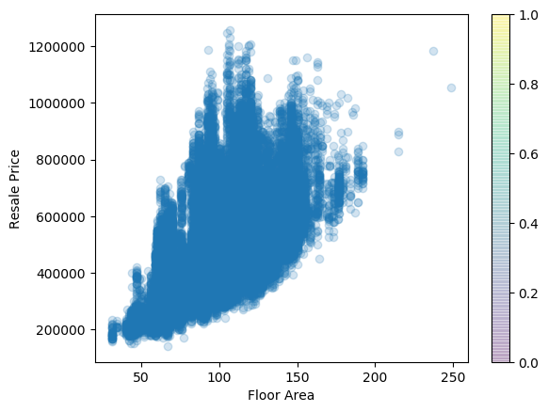
Conclusion
BTO flats are significantly more expensive
Bukit Panjang re-sale was proven meet the criteria as it is cheaper than BTO and increase throughout the time.
The ideal floor area would be 100 – 150 to be able to sell the flat for more than $400K.

